Slide 1
DBMS COURSE PROJECT
HELPING HANDS
Submitted by :-
Nileena P C B160213CS
Reema Sebi B160229CS
Vignesh Krishnan B160104CS

Slide 2
OBJECTIVE
The objective of this project is to create a user friendly website that can contribute to a number of social causes.
The various schemes we have included are Blood Donation,
Charitable Donations to social activities and also publicizing
socially relevant events by putting them up on our website.

Slide 3
INSPIRATION
Every day in our lives, we read about and observe many socially significant events happening in our society.
Most of us would have wanted to be a part of at least some of these events.
As a student of a primary engineering institution like NITC, we feel that we can give back to the society through a technical initiative.
We have created a website called ‘Helping Hands’ to ease the process of blood donations and funding charities and through this, create a big network of donors and philanthropists who are interested in giving back to the society.

Slide 4
ER DIAGRAM

Slide 5
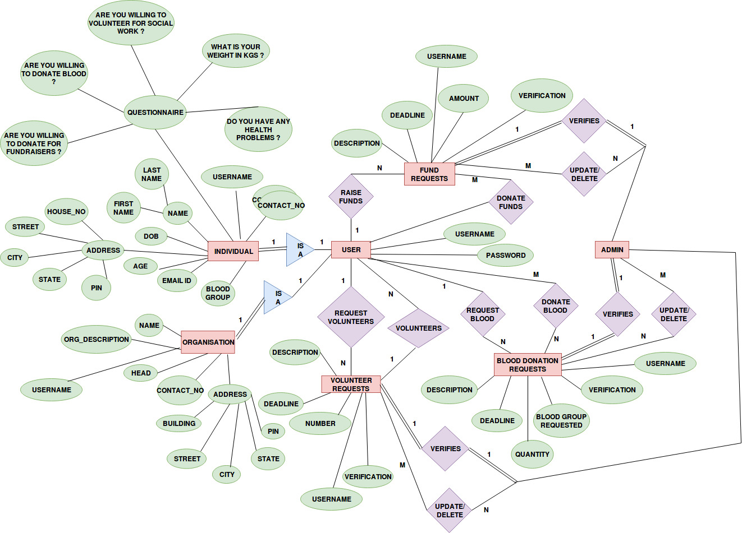

Slide 6
DATABASE
8 Relations :-
Details – Database containing all the information of the logged in individuals.
Orgs- Database containing all the information of the logged in organisations.
Fundraiser- Database that has the details of requests for fund raising.
Bloodrequests – Database that has details of requests for blood donation.

Slide 7
Campaigns – Database that has details of the campaigns that are being held which requires volunteers.
Donations – Database that contains details of donations by various users
Volunteers – Database that contains details of volunteers who have registered for various social campaigns
Messages – Database that contains all the messages and reviews by the guest users

Slide 8
RELATIONAL SCHEMA

Slide 9
RELATION: DETAILS
username | password | NAME | EMAIL | DOB | AGE | PHONE | ADDRESS | BLOOD GROUP | q1 | q2 | q3 | q4
The details of the indviduals are inserted into this table during registration.
Username acts as the primary key.
The relation is in 3-NF .

Slide 10
RELATION: ORGS
username | password | ONAME | ODESCRIPTION | OEMAIL | OADDRESS | OPHONE
The details of the ORGANISATIONS are inserted into this table during registration.
Username acts as the primary key.
The relation is in 3-NF .

Slide 11
RELATION:BLOODREQUESTS
username | Description | Blood_group | Deadline | Quantity | verified
The details of those who have requested for blood are stored.
Description is the primary key.
Username acts as a foreign key referring to the primary key in DETAILS or ORGS table.

Slide 12
RELATION: FUNDRAISER
Username | Fundraisername | Fdescription | Famount | Fdeadline | verified
The details of the fundraiser programmes are stored.
Fundraisername acts as the single primary key.
Username acts as a foreign key referring to the primary key in DETAILS or ORGS table.
The relation is in 3-NF

Slide 13
RELATION : DONATIONS
Username | Fundraisername | amount
This relation stores the details of the donations done by logged in users.
Username and fundraisername together acts as primary key.

Slide 14
RELATION : CAMPAIGNS
Username | Cname | Cdescription | cdeadline | Number | verified
This relation has the details of the on going social campaigns.
Cname is the primary key.
Username acts as a foreign key.

Slide 15
RELATION : VOLUNTEERS
Username | cname
This table is to store the data of the volunteers who have signed up for various social service campaigns.
Username and cname together acts as primary key

Slide 16
RELATION : MESSAGES
Name | Email id | message
This relation is used to store the messages that the guest users can send to the admin.

